Slide 1
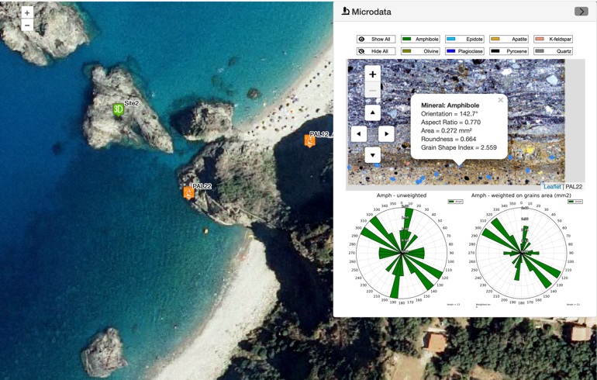

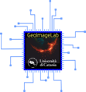
Web publication of multiscale geological data, methodology, and processes
Di Pietro G. , D’Agostino A. , Ortolano G. , Fazio E. ; Visalli R. , Musumeci R. E. , Cirrincione R.
https://geoimagelab-unict.it

Slide 2

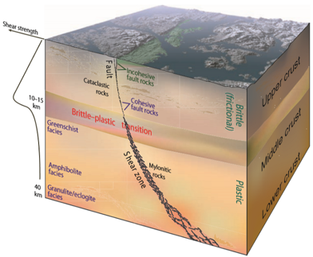
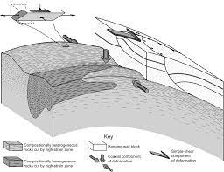
MYLONITIC rocks as snapshot of earth dynamics
“Web publication of multiscale geological data, methodology and process” - Di Pietro G. , D’Agostino A. , Ortolano G. , Fazio E. ; Visalli R. , Musumeci R. E. , Cirrincione R.
The mylonitic rocks record most of alteration at certain condition of Temperature, Pressure and Strain.
The rock fabric is related to the deep deformation in Share Zone and tectonic kinematics
Simplified model of the connection between faults, which normally form in the upper crust, and classic ductile shear zones. The transition is gradual and known as the brittle-plastic transition. The depth depends on the temperature gradient and the mineralogy of the crust. For granitic rocks it normally occurs in the range of 10-15 km. From Fossen, H. (2016)
Fault-related rocks can be considered also as TECTONITES (Ramsay and Huber, 1983) and then read/interpreted through the quantification of the chemical-physical counterbalancing factors driven by deformation vs. recovery processes
Introduction
Case of study
Developed methodology
Conclusion

Slide 3
MYLONITIC rocks as Moving picture of the earth
“Web publication of multiscale geological data, methodology and process” - Di Pietro G. , D’Agostino A. , Ortolano G. , Fazio E. ; Visalli R. , Musumeci R. E. , Cirrincione R.
Since the insight work of Wise et al. (1984), who classified the dynamics of fault-related rocks according to the competition between strain rate and rate of recovery, mylonitic rocks have become increasingly central in the reconstruction of plate kinematics, representing de facto a snapshot of Earth dynamics.
Introduction
Case of study
Developed methodology
Conclusion

Slide 4
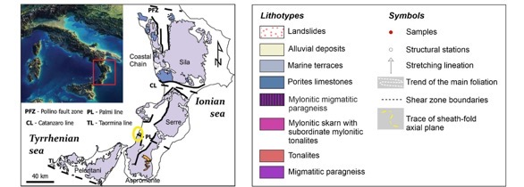
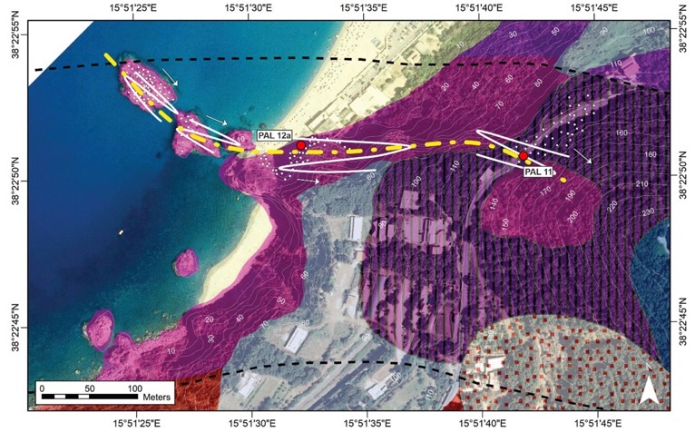
Palmi shear zone
“Web publication of multiscale geological data, methodology and process” - Di Pietro G. , D’Agostino A. , Ortolano G. , Fazio E. ; Visalli R. , Musumeci R. E. , Cirrincione R.
East-West direction
400 mt deep mylonitic foliations
Pervasive deformation starting in Paleocene and developed to Oligo-miocene
Geological background of the Palmi Shear Zone: Geological map of the Calabrian metamorphic complexes, geological Map of the case study area of the Palmi Shear zone with trends of the main foliations and average stretching lineations, (white circles represent location of each structural station, while red circles represent sample locations) (Ortolano et al. 2021)
Introduction
Case of study
Developed methodology
Conclusion

Slide 5
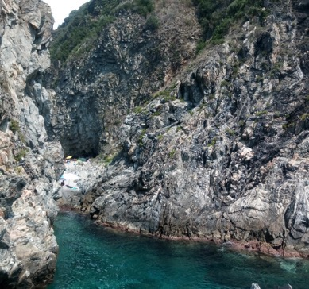
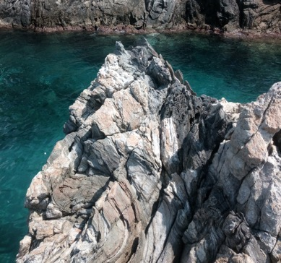
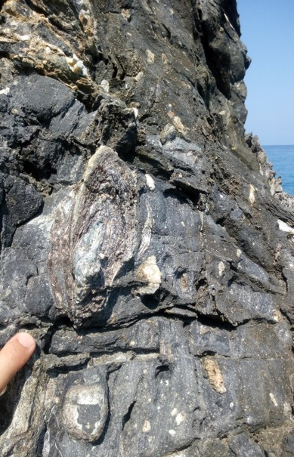
Palmi shear zone
“Web publication of multiscale geological data, methodology and process” - Di Pietro G. , D’Agostino A. , Ortolano G. , Fazio E. ; Visalli R. , Musumeci R. E. , Cirrincione R.
Clastic elements inside a carbonatic ultra-mylonitic matrix
Introduction
Case of study
Developed methodology
Conclusion

Slide 6
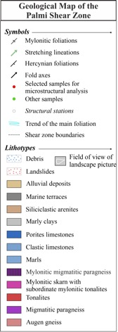
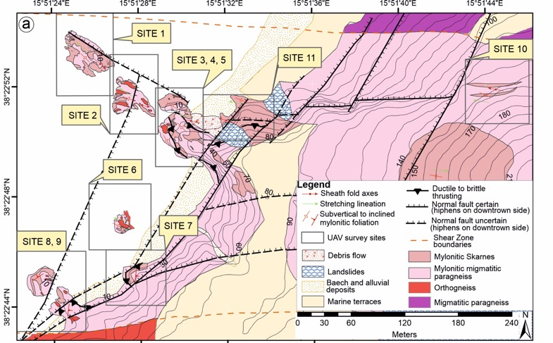
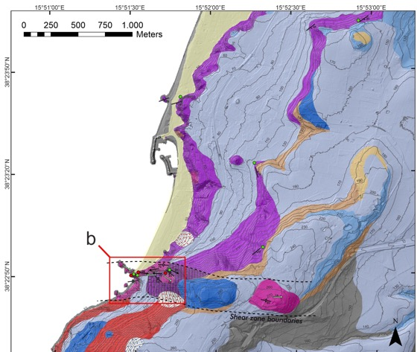
PALMI) shear zone
“Web publication of multiscale geological data, methodology and process” - Di Pietro G. , D’Agostino A. , Ortolano G. , Fazio E. ; Visalli R. , Musumeci R. E. , Cirrincione R.
Geological map of Palmi Shear Zone
High definition geological map, 1:350 scale ratio
Manually and UAV surveys
Published in a special issue of Structural Geology in 2024
(Fazio et al, 2024)
Introduction
Case of study
Developed methodology
Conclusion

Slide 7
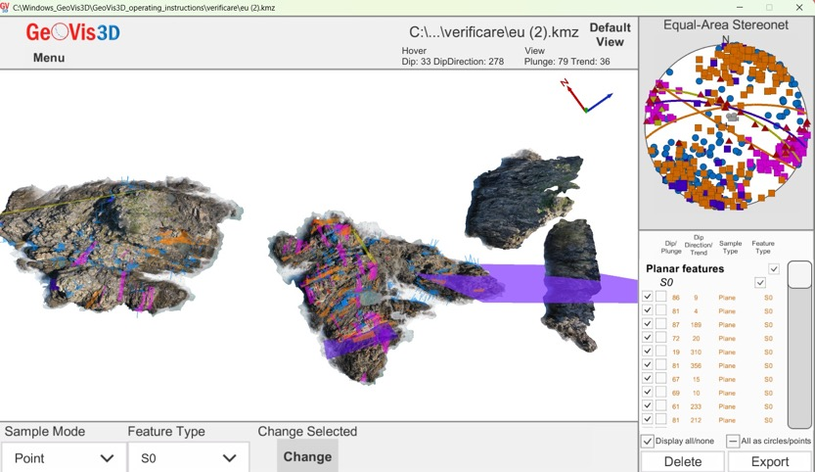
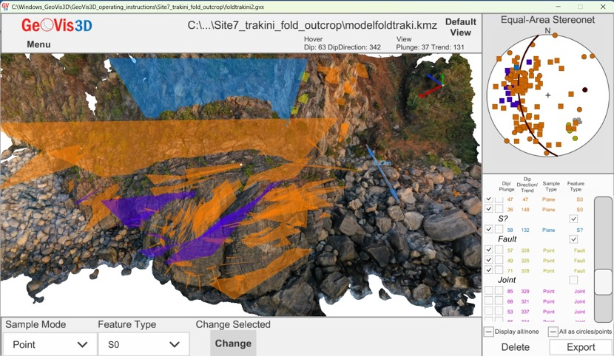
PALMI (south-ITALY) shear zone
“Web publication of multiscale geological data, methodology and process” - Di Pietro G. , D’Agostino A. , Ortolano G. , Fazio E. ; Visalli R. , Musumeci R. E. , Cirrincione R.
Mesoscale data of layers;
Stereoplots;
3D definition
Introduction
Case of study
Developed methodology
Conclusion

Slide 8
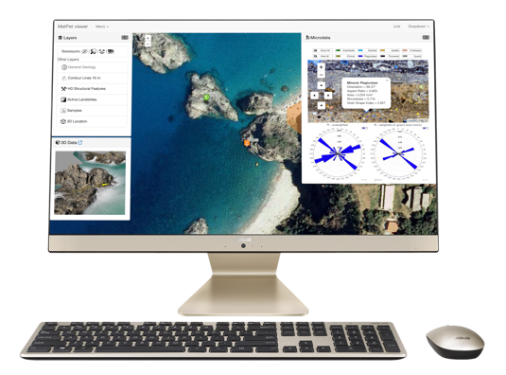
From data to web-publishing
“Web publication of multiscale geological data, methodology and process” - Di Pietro G. , D’Agostino A. , Ortolano G. , Fazio E. ; Visalli R. , Musumeci R. E. , Cirrincione R.
Geo-graphic data
Maps, rasters
Geo-spatial data
3D models
AR and VR
Digital twins
Micro-data (samples)
Thin-sections
Geochemical data
Petrological data
And more…
Features
Points
it is necessary to contend with different paradigms of representation and well-differentiated information technologies to let users visualize and query data on the web
Introduction
Case of study
Developed methodology
Conclusion

Slide 9
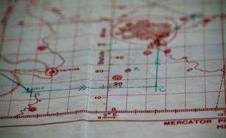
What issues?
“Web publication of multiscale geological data, methodology and process” - Di Pietro G. , D’Agostino A. , Ortolano G. , Fazio E. ; Visalli R. , Musumeci R. E. , Cirrincione R.
Skill gaps for data scientist in web development
Data are often un-interoperable and not visualized without proprietary software
Very difficult to visualize and query data in one viewer.
Introduction
Case of study
Developed methodology
Conclusion

Slide 10
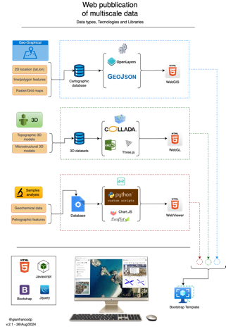
The production process for multiscale and multidimensional data viewing
“Web publication of multiscale geological data, methodology and process” - Di Pietro G. , D’Agostino A. , Ortolano G. , Fazio E. ; Visalli R. , Musumeci R. E. , Cirrincione R.
Using free and open-source technologies
Constrains:
Human-readable data files and structures
Easy to serialize data type for a serverless approach
Technologies with a large opensource community
Introduction
Case of study
Developed methodology
Conclusion

Slide 11
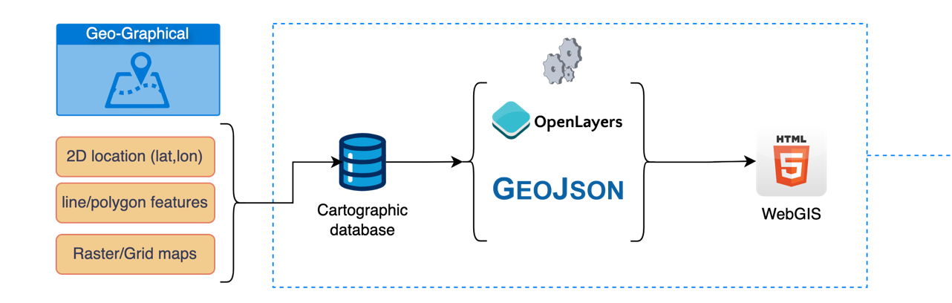
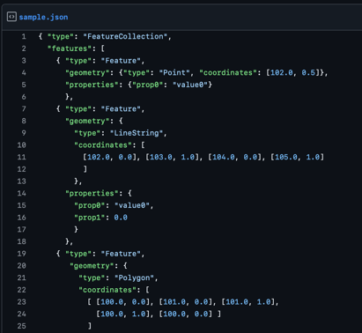
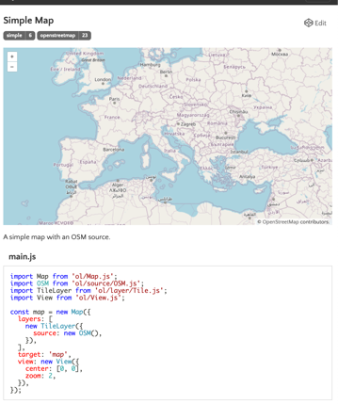
Geographical data - Data type: Geojson, OGC standard, Javascript object notation, easy to use and very popular format for geo-data and attribute tables - Script library: OpenLayers, OpenSource project with a very large community, easy to deploy maps on the web process
“Web publication of multiscale geological data, methodology and process” - Di Pietro G. , D’Agostino A. , Ortolano G. , Fazio E. ; Visalli R. , Musumeci R. E. , Cirrincione R.
Introduction
Case of study
Developed methodology
Conclusion

Slide 12
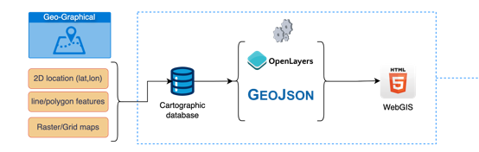
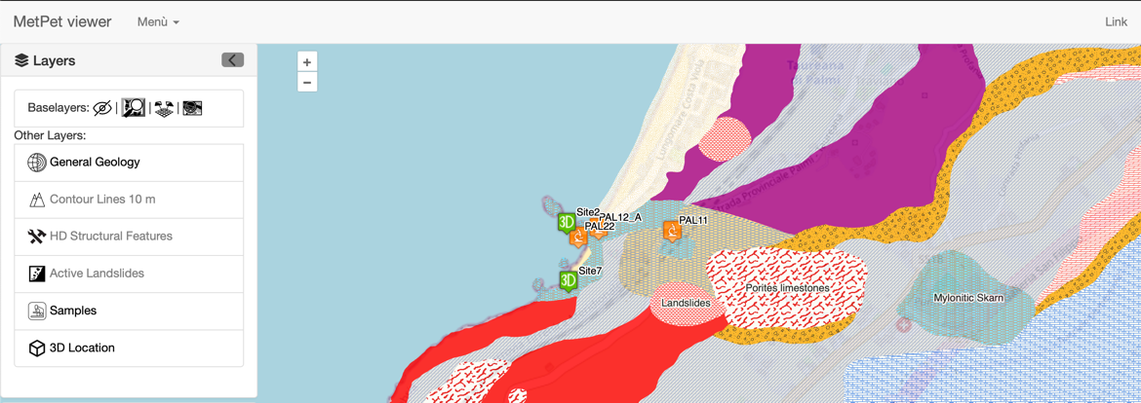
“Web publication of multiscale geological data, methodology and process” - Di Pietro G. , D’Agostino A. , Ortolano G. , Fazio E. ; Visalli R. , Musumeci R. E. , Cirrincione R.
Introduction
Case of study
Developed methodology
Conclusion

Slide 13
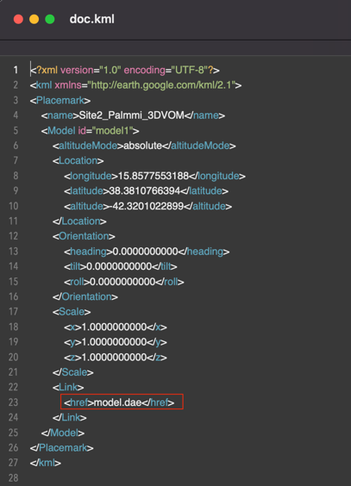
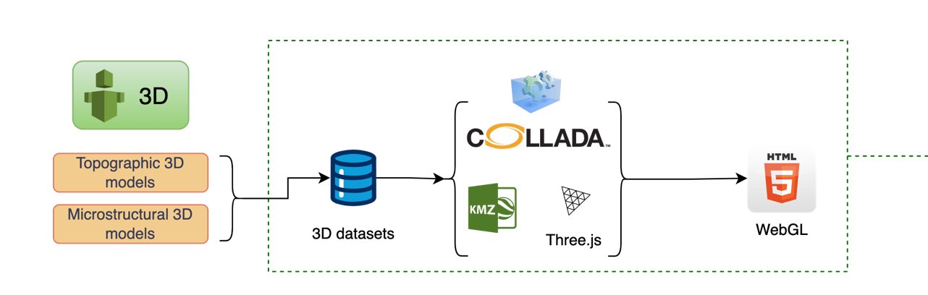
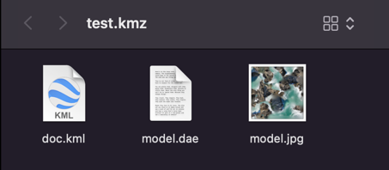
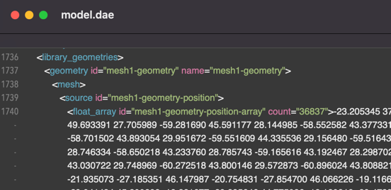
“Web publication of multiscale geological data, methodology and process” - Di Pietro G. , D’Agostino A. , Ortolano G. , Fazio E. ; Visalli R. , Musumeci R. E. , Cirrincione R.
3D data - Data type: COLLADA (.dae) + KML = KMZ, OGC standard, XML-like human-readable format. - Script library: Three.JS, the most used opensource 3d script library on the web
Introduction
Case of study
Developed methodology
Conclusion

Slide 14

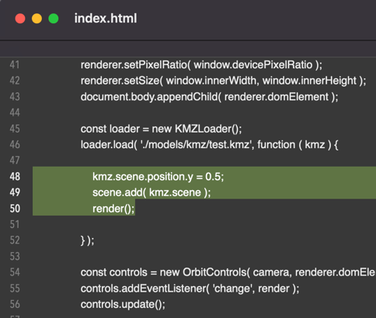
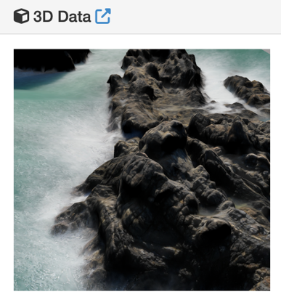
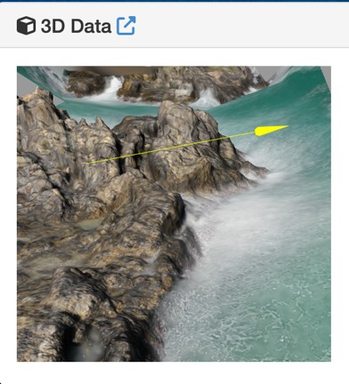
“Web publication of multiscale geological data, methodology and process” - Di Pietro G. , D’Agostino A. , Ortolano G. , Fazio E. ; Visalli R. , Musumeci R. E. , Cirrincione R.
Introduction
Case of study
Developed methodology
Conclusion

Slide 15
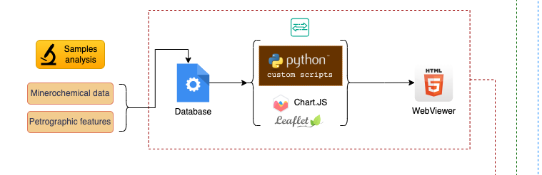
Sample analysis data
“Web publication of multiscale geological data, methodology and process” - Di Pietro G. , D’Agostino A. , Ortolano G. , Fazio E. ; Visalli R. , Musumeci R. E. , Cirrincione R.
Minerochemical, petrographic and other data from thin sections
No open-source projects with a large community
No interoperable file standards accepted and used from a large community.
OpenSource tools: GDAL for map-tiles, CharJS for diagrams, LeafLet for query and webLIS
Introduction
Case of study
Developed methodology
Conclusion

Slide 16
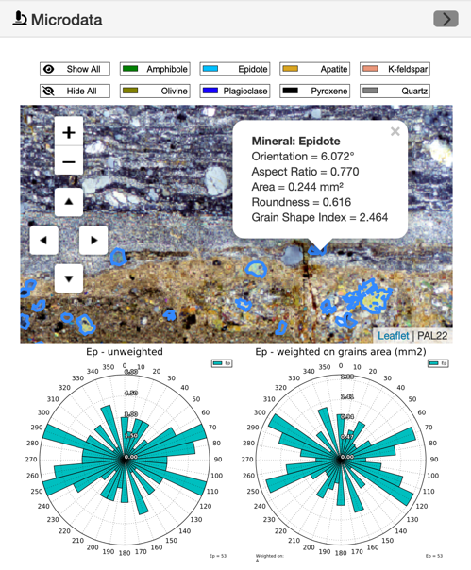
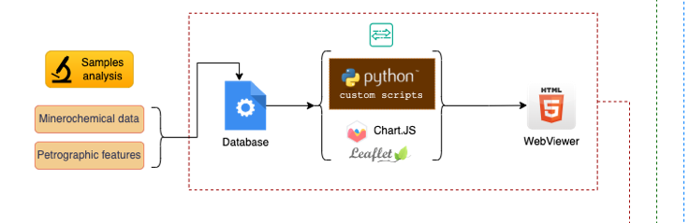
“Web publication of multiscale geological data, methodology and process” - Di Pietro G. , D’Agostino A. , Ortolano G. , Fazio E. ; Visalli R. , Musumeci R. E. , Cirrincione R.
Python toolbox developed
Easy to deploy an HTML viewer of minerochemical features
Thin sections are converted in tilemap using a local coordinate reference system and LeafLet Javascript library.
Entire process grant supervision by basic web-developer skills
Introduction
Case of study
Developed methodology
Conclusion

Slide 17
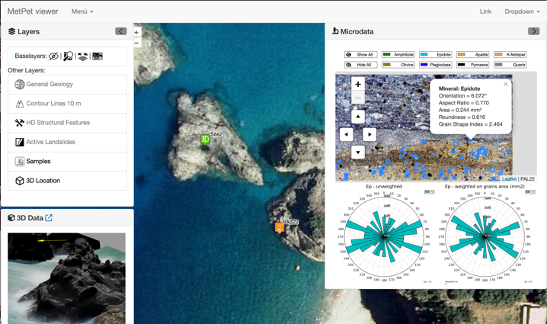
Conclusion
“Web publication of multiscale geological data, methodology and process” - Di Pietro G. , D’Agostino A. , Ortolano G. , Fazio E. ; Visalli R. , Musumeci R. E. , Cirrincione R.
https://gianfrancodp.github.io/metpet/
Free and opensource templates and layout;
Convenient packaging into a global website using <iframe> tag;
The toolboxes can provide output for serverless and DB-less publishing approach;
Easy to deploy to a blog/website page or a local viewer.
Introduction
Case of study
Developed methodology
Conclusion

Slide 18
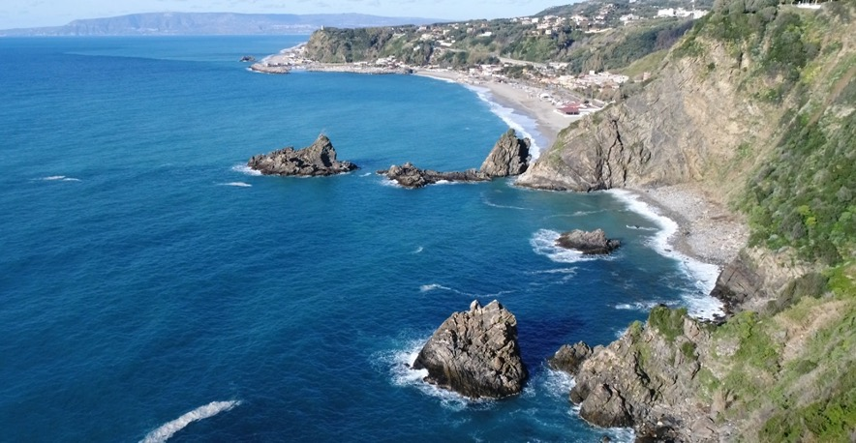
Future developments
“Web publication of multiscale geological data, methodology and process” - Di Pietro G. , D’Agostino A. , Ortolano G. , Fazio E. ; Visalli R. , Musumeci R. E. , Cirrincione R.
Executable (without Python) toolbox for convenient packaging of multiscale web viewer
Improve 3D visualization features
Expand to other microstructural features
Cloud publishing feature in custom server (Amazon AWS, Google Cloud ecc.)
Credit: Stefano Pannucci
Introduction
Case of study
Developed methodology
Conclusion

Slide 19
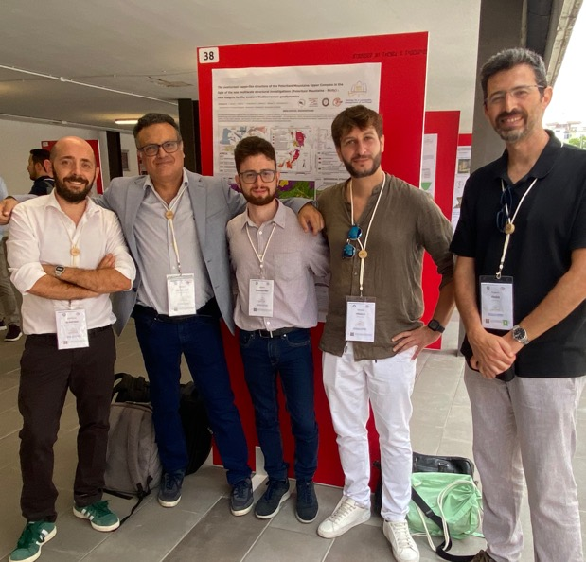
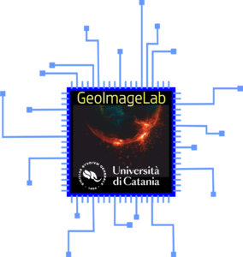
Thank You
“Web publication of multiscale geological data, methodology and process” - Di Pietro G. , D’Agostino A. , Ortolano G. , Fazio E. ; Visalli R. , Musumeci R. E. , Cirrincione R.
https://geoimagelab-unict.it

